Slide 1
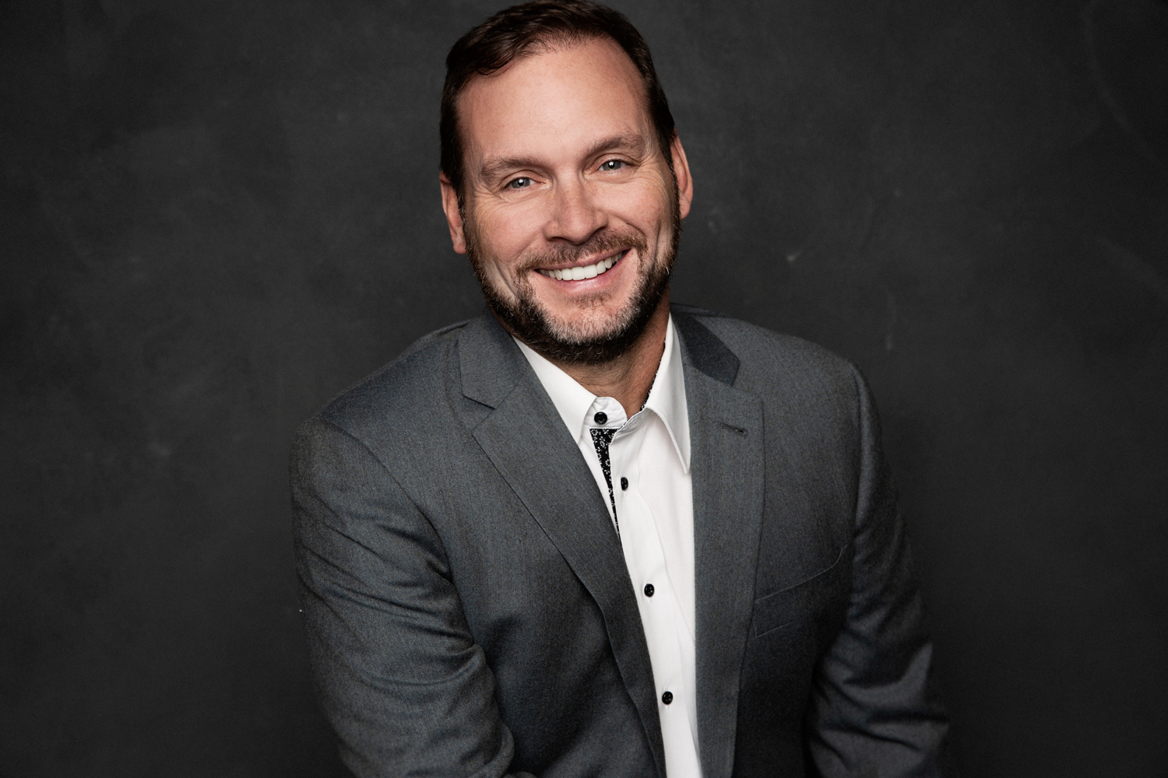
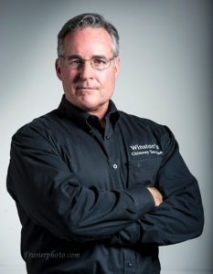
Chimney Business in the United States
With Mark Stoner & Chuck Hall
Notes:
3 stages of chimneys businesses.
Single and good
2-4 and getting a little better
Growth oriented
Who are you? Raise your hands.
Are you ok if I piss you off and change the way you have thought about some things?
Are you coming here to get”fixed”
Accountant. Sweetened Oat cereal.

Slide 2
What we will Cover today
Hiring
Training
Sales
Marketing
Leadership

Slide 4
How Much Time Do You Have Left?
0
20
40
60
80
Free
Work
Sleep
24

Slide 5
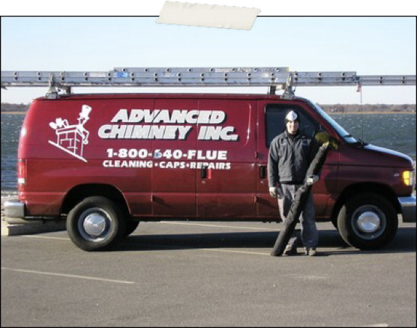
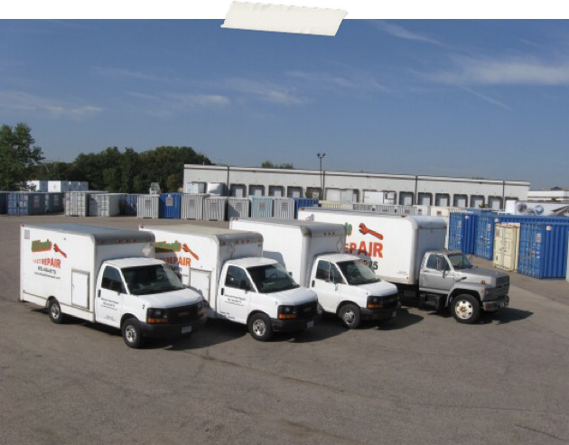
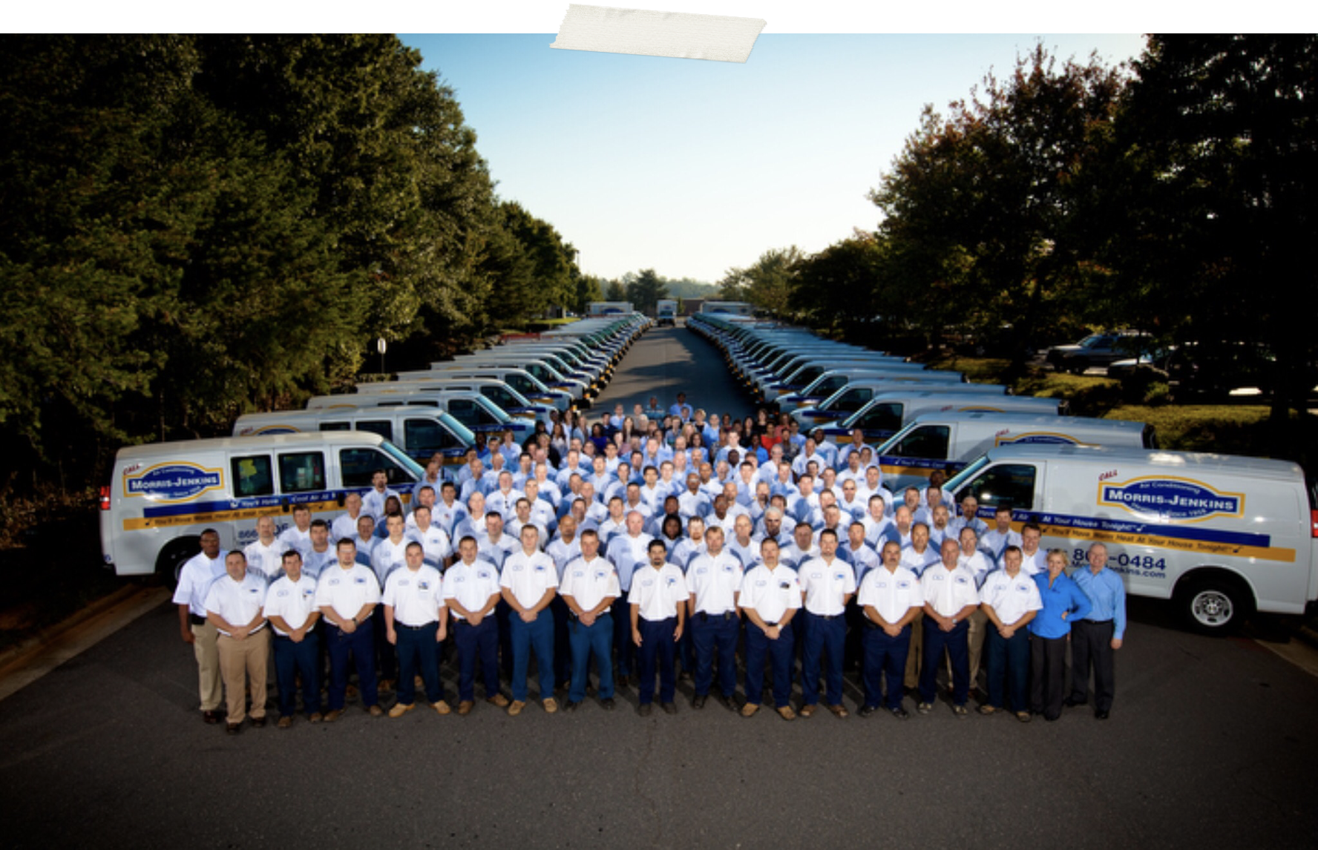
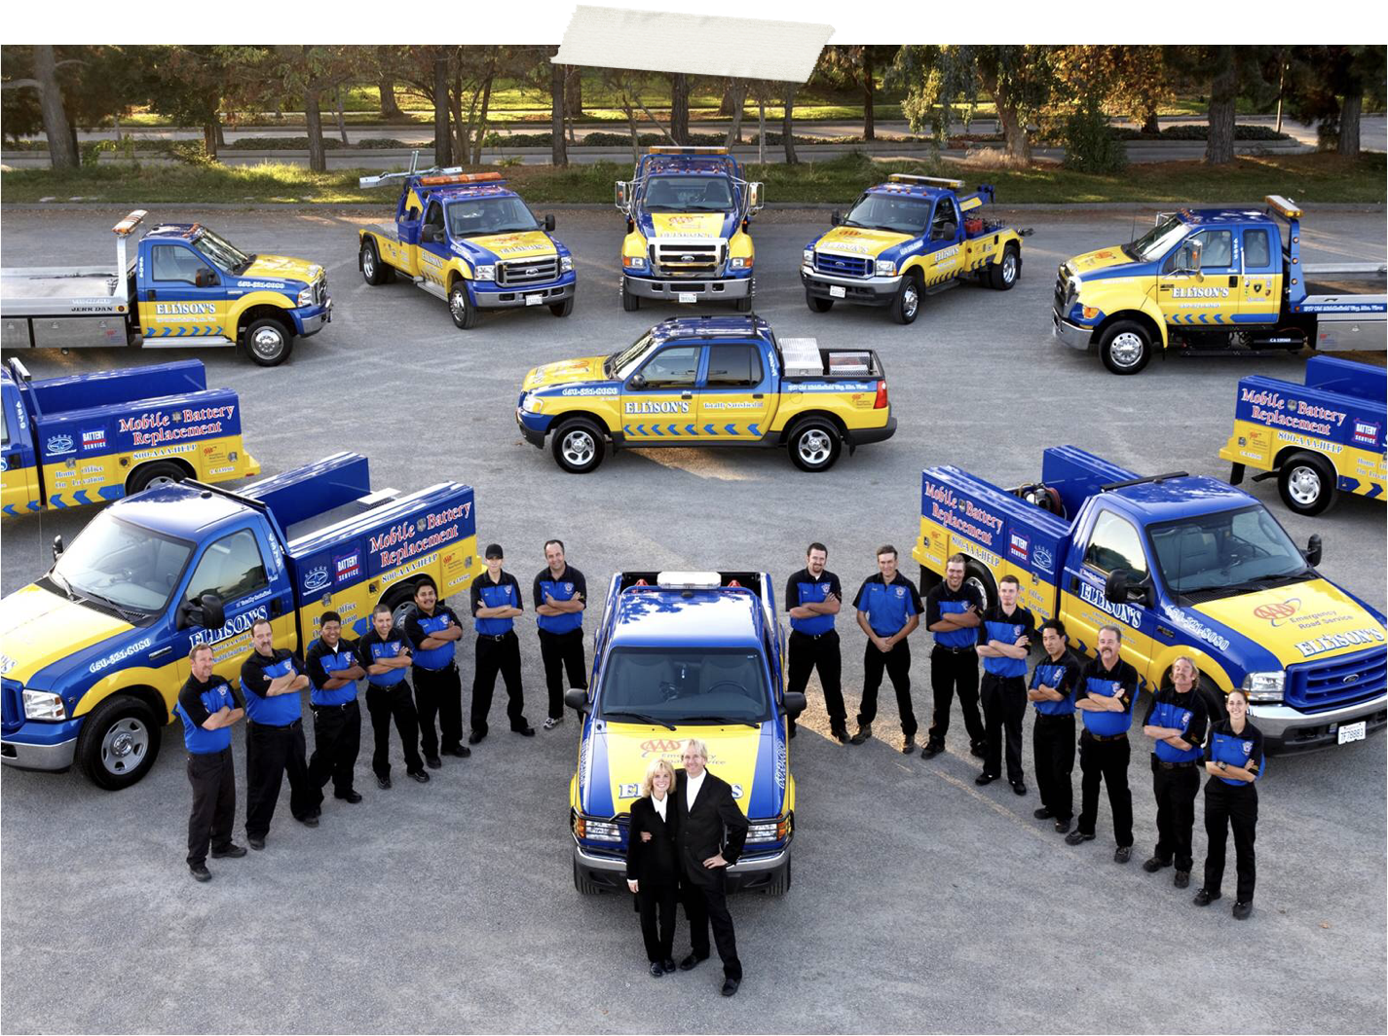
Setting Your GPS
What is the size company you want?

Slide 6
Hiring
The big wall
Your business will totally change the day you start taking some of your time and say “my job is not to run the company, my job is to find people smarter than me to run the company.”
Notes:
If you suck at hiring you are dead in the water

Slide 7
How We recruit
Create a story about who you are
Stop using old hiring ads
Indeed. Keywords Templates.
Hire people’s friends
Paid apprenticeships with a career plan. Online training and paths to certification.
Great pay and benefits are important. Benefits starting to be more important.
Meaningfulness, Direction and Appreciated.
They can be looking for more responsibility, more pay, more benefits, the goal posts, a change.

Slide 8
Commission Based Pay
The Good and the Bad
The Most Fair
Makes ScoreKeeping and goals easier
Less likely to lose technicians
Very difficult to start - ideas on rolling it out
Most of my clients want to know how to do this
Changes their motive to do a more though inspection

Slide 9
Train and Educate

Slide 10
Education is Now the competitive edge
Train them and they leave? Don’t train them and they stay? Now if you don’t invest in them they leave and usually those aren’t the one you wanted to leave.
Change from “know it all cultures to learn it all cultures.
Online platforms, CSIA training, Olympia/ Copperfield, Facebook ( to a degree) www.surefire.online
Don’t out learn your team
Many techs that come to us say there was little or no training, no safety, no direction for them at other companies.

Slide 11
Chimney Cap Gold!

Slide 12
Financing
Approximately 80% of home improvements are financed
Our jobs are getting bigger and bigger
$5000 x 6.99% x 60 months = $98.98
#1 plan is 12 months SAC. We pay 7%
People do more and bigger projects.
Don’t ask them if the want financing

Slide 13
Marketing

Slide 14
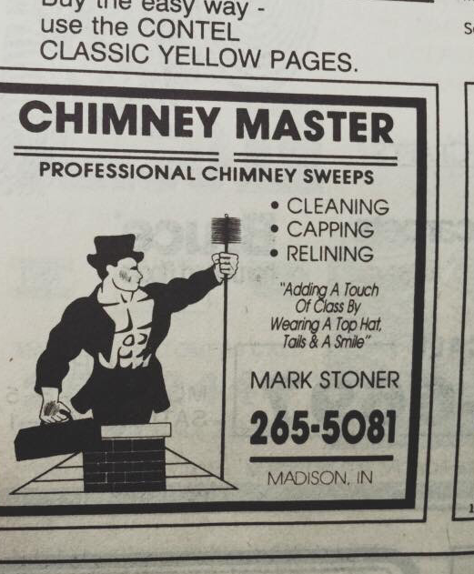
My First Step into Marketing
Notes:
Thank you Jeremy
The top hat was my first marketing effort.
Then the yellow pages

Slide 15
Website
Networking
Guerrilla Marketing - Yard Signs
Lead Generation Platforms
Facebook/Social Media
Video
Direct Mail / Magazines
Home Shows/Street Fairs
TV / Radio
CSIA
Charity and Fun Stuff

Slide 16
#1 Mistake most companies make is that they don’t market to current customers.
We send 3-5 post cards per customer for the first 3 years then at least 1-2 per year after that.
Thank you, Christmas, Earth Day, Annual Service, Warranty Compliance etc.

Slide 17
Do you even say thank you?
Notes:
Copperfield candy in shipments

Slide 18
Most companies will budget 5% to 12% of gross sales for marketing.
I think you need to move probably 1/2 of your marketing budget to recruiting
Tracking of calls and actual sales from each campaign is necessary
Not all campaigns can be effectively tracked just by phone calls.
Many companies cut marketing when times are tough

Slide 19
Using Videos Effectively

Slide 20
Newspaper and Magazine Readership is Down
The use of Video Marketing has skyrocketed

Slide 21
Using Video allows you to begin building 2 very important parts of the Sales Process

Slide 26
TV

Slide 27
Seeing is believing

Slide 28
In the consumers eyes we are equal until someone demonstrates they are superior
Using video allows you to demonstrate how you are superior

Slide 29
Facebook generates 8 billion video views on average per day (Source: Social Media Today)

Slide 30
Why Video?
By 2022, online videos will make up more than 82% of all consumer internet traffic — 15 times higher than it was in 2017. (Cisco)
78% of people watch online videos every week, and 55% view online videos every day. (HubSpot)
Viewers retain 95% of a message when they watch it in a video, compared to 10% when reading it in text. (Insivia)

Slide 31
Ideas for Video Content
Company Story
Sweeping & Inspection
Ventilation Cleaning
Save $ with Efficiency
Saving the Environment
Video Blogs
Training; SOP’s
Chimney Repair
Recruiting
Charity Work
Community Involvement
How a sweep helps make the home safer

Slide 32
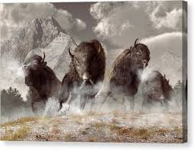
Be Like a Buffalo

Slide 33
Leadership Is everything
Notes:
No more Mr. Nice guy.
Your main job is to set the vision for everyone in the company...and make sure it happens.

Slide 34
Understand the stages of growth
It’s your job to move the team through the stages.
You have the company you deserve.
How can you be beat?...besides price.
Know when to pivot the company. Construction, Gas, Other verticals
The answer to growing is not doing more of what you are currently doing.

Slide 35
To compete in a Free market summary
We do not compete on price….we are almost always the most expensive
We build the best teams with the most educated chimney professionals
We pay very very well
We are the most innovative companies with new products and methods
We tell our stories better than the others through marketing
We are growing and we can provide faster and more thorough service.

