Slide 1
The chimney sweep trade from the view of a female employee

Slide 2
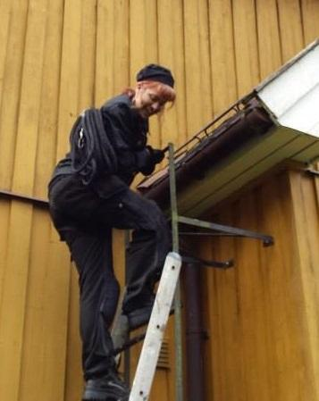

Slide 3


Slide 4
Why should you hire a female chimney sweep?
❁ Morale boost
❁ Reflecting your customers
❁ Selling more services
❁ Attractive contractor/customer
❁ Attractive workplace
❁ Profitability
❁ Safety in the workplace
❁ More fun!

Slide 5

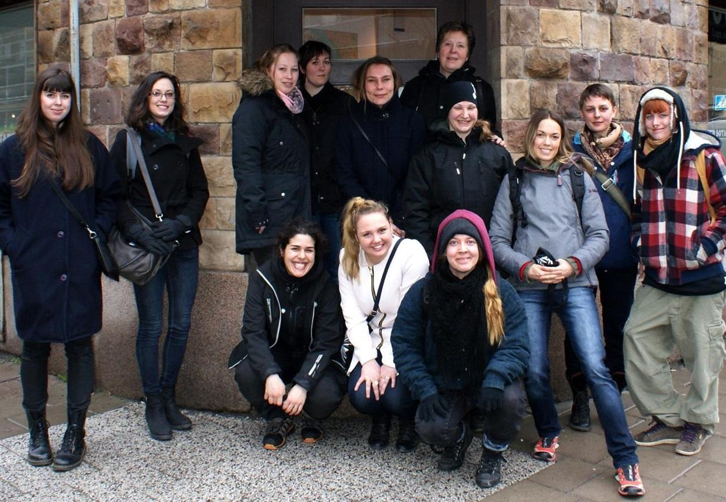
Knopargajarna

Slide 6


Slide 7


