Slide 1
Leak testing of ventilation systems according to DIN EN 12599 Wöhler DP 700

Slide 2
Air is the most important of all food!
Every day, a you need…
How long does a person live without...
1 kg soild food
3 kg liquid food
Air
Water
Food
20 kg air
ca. 3 Min.
ca. 3 Day
ca. 3 Months

Slide 3
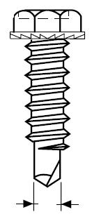
Short test - Effect of leakages
First a quick test with the DP 700!
Question: How much air get lost ( in liters) through an open screw hole at 1000 Pa?
by a single
open hole of a screw,
go at 1000 Pa per hour almost 1,0 m³ air lost!
~ 0,3 l/s
at 1000 Pa
3 mm
Notes:
egal wie grpóß die Anlage ist, wenn wir sie mit 1.000PA Druck beaufschlagen und es ist nur ein kleines Schraubenloch vorhanden strömen in der Sekunde 0,3l ( 1 Glas Bier) hinnaus.

Slide 4
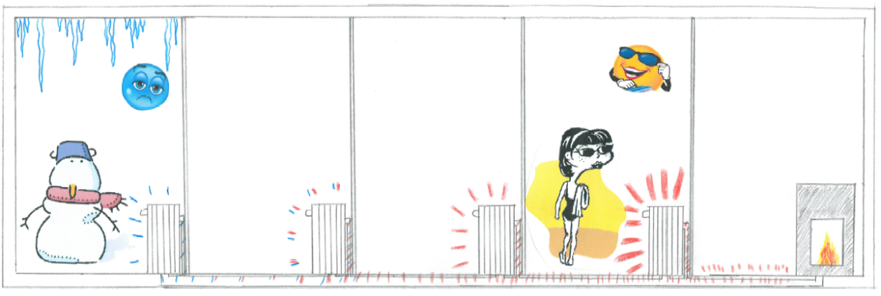
Air line leaks are not so important?
Sometimes you can hear the argument that the (leaky) air still benefits the building!
This be true in some cases, but ...
Imagine a heating system in which the piping is insufficiently insulated or not insulated at all?
Right, the last heating system stays cold!

Slide 5
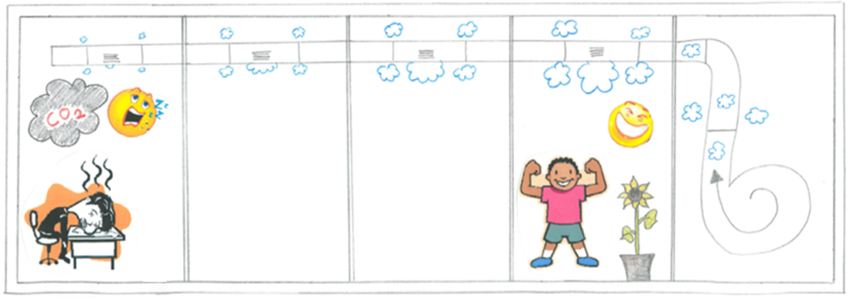
Air line leaks are not so important?
The same applies to the leakage of air ducts
The fresh air reduced to the end
Notes:
Daher erst erfragen, ob es Beschwerden/ Komforteinbußen gibt, bevor man anfängt an der Anlage zu optimieren

Slide 6
DIN EN 12599
DIN EN 12599 – Ventilation for buildings –
Test procedures and measurment methods to hand over
air conditioning and ventilation systems

Slide 7
DIN EN 12599 - Index
Inxex
scope
normative references
test method
completeness checks
functional checks
function measurements
special measurements
measurement uncertainties
test reports
Scope of the standard: 85 pages. From page 26 Appendices!

Slide 8
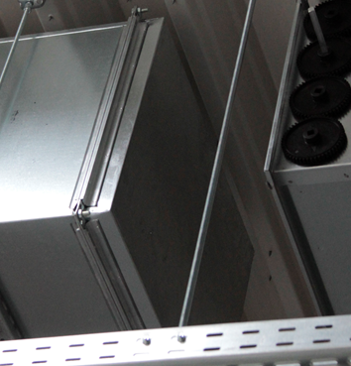
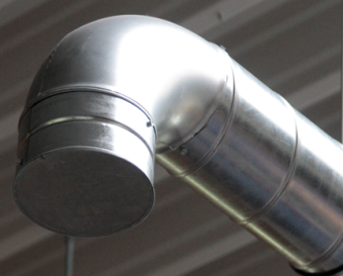
Leak test according to DIN EN 12599
"As soon as a sufficiently large part of the air duct system is installed, openings will be closed.“
All air outlets and ducts to the main line or air handling unit or fan must be closed, except for 2 connections for the test unit.
It is useful to use system-compliant end covers or inflatable rubber bubbles for round systems, which can also be used through inspection openings, for example.
The system builder should prepare the installation of the closures!
In the case of rectangular air ducts, sheets can be inserted between the flange connections for smaller cross-sections.
Closing the openings with foil and tape requires special care
Notes:
wie hat so eine Messung abzulaufen?

Slide 9
Leak test according to DIN EN 12599
„ A ventilation fan, connected to the sealing air duct area by a monitoring device, generates a positive or negative pressure to the atmosphere (test pressure)".
„ The test pressure should be set to one of the following values, preferably in the middle of the mean working pressure:
200 Pa, 400 Pa or 1 000 Pa as overpressure for supply air lines
or
200 Pa, 400 Pa or 750 Pa as vacuum for exhaust ducts.”
The operating pressure is the plant by manufacturer or the test pressure is a specification of the planner.
Notes:
Informationen kommen vom Hersteller, welcher Betriebsdruck genutzt wird

Slide 10
DIN EN 12599 - Scope of measurements
„ In the case of functional tests or measurements in a system, it`s necessary to repeat the same procedure at different points."
„ With a view to reducing working hours, tests may be made on a sample basis."
The standard provides information on the percentage of the duct to be measured, depending on the size and number of air outlets

Slide 11
Normative requirements
Task of the leak test: Classification of the air duct system
The tightness classes are named in the basic standard DIN EN 13779. This standard has now been replaced by DIN EN 16798-3 Tightness class B is the minimum requirement for assembled air duct systems (cf. e.g. DIN 1946-6)
Task of the leake test |  |  |  | limit Leakage air rate (fmax) m³ s⁻¹m⁻²
DIN EN 13779 | DIN EN 16798-3 | EUROVENT 2/2 | DIN 24194 Teil 2
 | ATC 7 |  |  | Nicht klassifiziert
 | ATC 6 |  |  | 0,067 5 x p_{t}^{0.65} x 10⁻³
A | ATC 5 | A | II | 0,027 x p_{t}^{0.65} x 10⁻³
B | ATC 4 | B | III | 0,009 x p_{t}^{0.65} x 10⁻³
C | ATC 3 | C | IV | 0,003 x p_{t}^{0.65} x 10⁻³
D | ATC 2 |  |  | 0,001 x p_{t}^{0.65} x 10⁻³
 | ATC 1 |  |  | 0,000 33
Notes:
DIN EN 13779
Lüftung von Nichtwohngebäuden - Allgemeine Grundlagen und Anforderungen für Lüftungs- und Klimaanlagen und Raumkühlsysteme; Deutsche Fassung EN 13779:2007

Slide 12
Functional measurements - Leak tightness of air line system
To be agreed upon in the contract/to be written out!
special measurement
The leakage air flow should be measured during installation of the system.
Wöhler DP 700

Slide 13
Functional measurements - Leak tightness of air line system
To be agreed upon in the contract/to be written out!
special measurement
The leakage air flow should be measured during installation of the system.
As soon as a sufficiently large part of the air duct system has been installed, the openings are "closed“
One usually checks approx. 100 - 300 m², but at least 10 m². For KWL systems 20 - 50 m², but at least 3 m².
Wöhler DP 700

Slide 14
Functional measurements - Leak tightness of air line system
To be agreed upon in the contract/to be written out!
special measurement
The leakage air flow should be measured during installation of the system.
As soon as a sufficiently large part of the air duct system has been installed, the openings are "closed“
One usually checks approx. 100 - 300 m², but at least 10 m². For KWL systems 20 - 50 m², but at least 3 m².
Test pressures should preferably be in the middle of the mean operating pressure.
Positive pressure for supply air lines, negative pressure for return air lines.
Wöhler DP 700

Slide 15
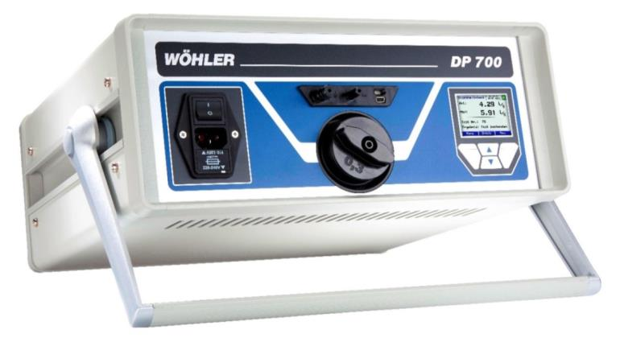
Wöhler DP 700 LEAKAGE TESTER
Leak test on ventilation systems and components

Slide 16
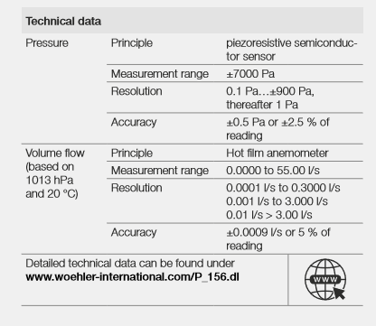
Functions and technical data
large capacity range up to 200 m³/h Leakage volum
over- and underpressure testing
Reaches the highest accuracy requirements according to DIN EN 15727 for measurement on individual components (± 0.0009 l/s)
Optional automatic measurement or manual measurement
Notes:
DIN EN 15727
Lüftung von Gebäuden - Luftleitungen und Luftleitungsbauteile, Klassifizierung entsprechend der Luftdichtheit und Prüfung; Deutsche Fassung EN 15727:2010

Slide 17
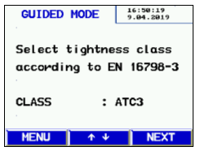
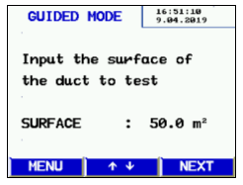
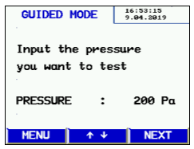
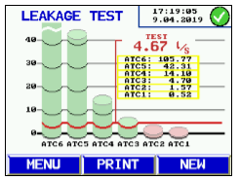
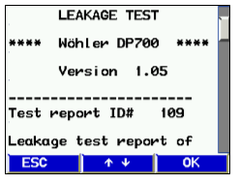
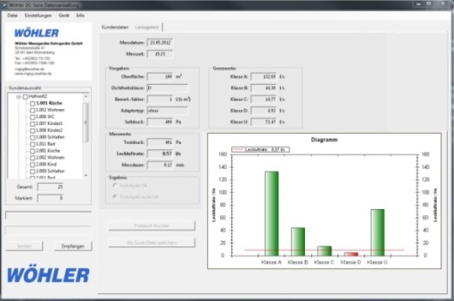
Functional measurements - Leak tightness of air line system
With the answer of 3 questions using the Wöhler DP 700 to classify an air duct system (user guidance)
Notes:
5minuten pro durchlauf

Slide 18
Advantages - Wöhler DP 700
Handy set with 2 suitcases
Simple operation with user guidance or in expert mode
Data storage in the device
Clear presentation of results
With simple user guidance:
With 3 entries to classify an air duct system or component

Slide 19
Application variety
Leakage test on air duct systems in accordance with DIN EN 12599 - Test and measurement methods for the transfer of ventilation and air conditioning systems
Testing of components of air duct systems according to product standards
DIN EN 15727, DIN EN 1507, DIN EN 12237, DIN EN 13180, DIN EN 1751
Tightness tests on
Air conditioning units, air conditioning cabinets, heat exchangers
Rooms and isolators in clean room technology according to VDI 2083 Part 19:2016-10 - Clean room technology - Leak tightness of containments; classification, planning and testing
Switch and server cabinets (functional safety of the extinguishing system!)
generally on enclosures with tightness requirements, e.g. for hygiene/cleanliness reasons

Slide 20
Bianca Böhner
Dozent Wöhler Wissen
Wöhler Technik GmbH
Wöhler-Platz 1
D-33181 Bad Wünnenberg

